Slide 1
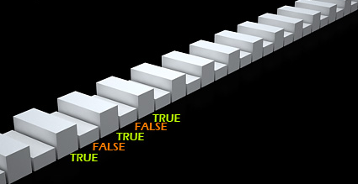





C Conditional Statements
Using Control-Flow Logic in C
Programming with C
SoftUni Team
Technical Trainers
Software University
http://softuni.bg

Slide 2

Table of Contents
Comparison and Logical Operators
The if Statement
The if-else Statement
Nested if Statements
The switch-case Statement

Slide 3

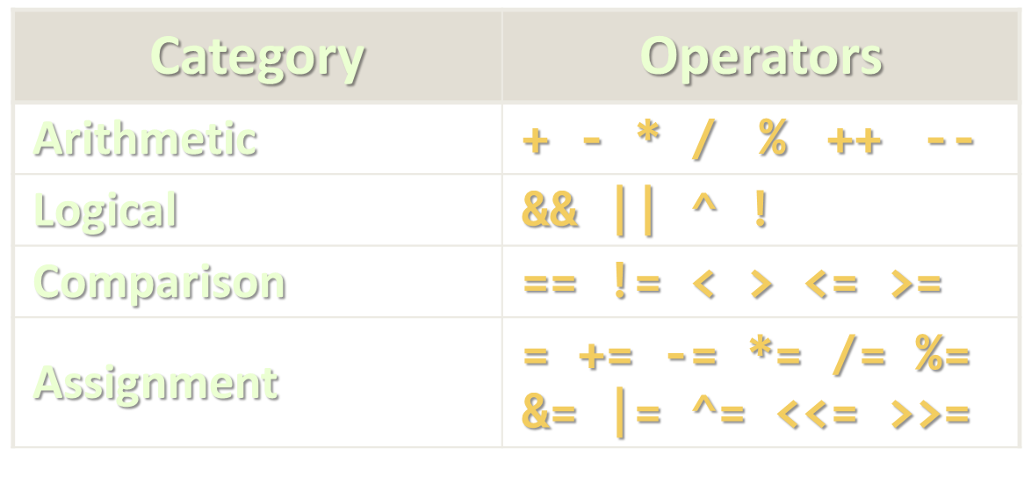
Comparison and Logical Operators

Slide 4
Comparison Operators
Operator | Notation in C# | Applicable for
Equals | == | strings / numbers / dates / most objects
Not Equals | !=
Greater Than | > | numbers / dates / comparable objects
Greater Than or Equals | >=
Less Than | <
Less Than or Equals | <=
Example:
int result = (5 <= 6);
printf("%d", result); // 1

Slide 5

Logical Operators
Operator | Notation in C# | Example
Logical NOT | ! | !false → true
Logical AND | && | true && true → true
Logical OR | || | true || false → true
Logical Exclusive OR (XOR) | ^ | true ^ false → true
De Morgan laws
!!A ⬄ A
!(A || B) ⬄ !A && !B
!(A && B) ⬄ !A || !B

Slide 6

if and if-else
Implementing Conditional Logic

Slide 7
The if Statement
The simplest conditional statement
Enables you to test for a condition
Branch to different blocks in the code depending on the result
The simplest form of the if statement:
if (condition)
{
statements;
}

Slide 8

Condition and Statement
The condition can be:
Integer variable – 0 for false, 1 for true
Boolean logical expression (evaluates to 0 or 1)
Comparison expression (evaluates to 0 or 1)
Every other type (0.0, '\0', NULL evaluate to 0)
The statement can be:
Single statement ending with a semicolon
Block enclosed in curly braces

Slide 9
How It Works?
The condition is evaluated
If it is true, the statement is executed
If it is false, the statement is skipped
condition
false
true
statements

Slide 10
The if Statement – Example
int main()
{
int biggerNum, smallerNum;
printf("Enter two numbers:\n");
scanf("%d", &biggerNum);
scanf("%d", &smallerNum);
if (smallerNum > biggerNum)
{
biggerNum = smallerNum;
}
printf("The greater number is %d.", biggerNum);
return 0;
}
Pass the address of biggerNum
Evaluates to 0 or 1

Slide 11

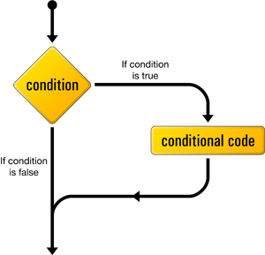
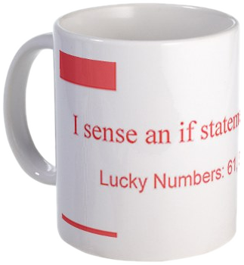
The if Statement
Live Demo

Slide 12
The if-else Statement
More complex and useful conditional statement
Executes one branch if the condition is true, and another if it is false
The simplest form of an if-else statement:
if (expression)
{
some_statement;
}
else
{
another_statement;
}

Slide 13
How It Works?
The condition is evaluated
If it is true, the first statement is executed
If it is false, the second statement is executed
condition
false
second
statement
true
first
statement

Slide 14
if-else Statement – Example
Checking a number if it is odd or even
int num;
scanf("%d", num);
if (num % 2 == 0)
{
printf("This number is even.");
}
else
{
printf("This number is odd.");
}

Slide 15
The if-else Statement
Live Demo

Slide 16
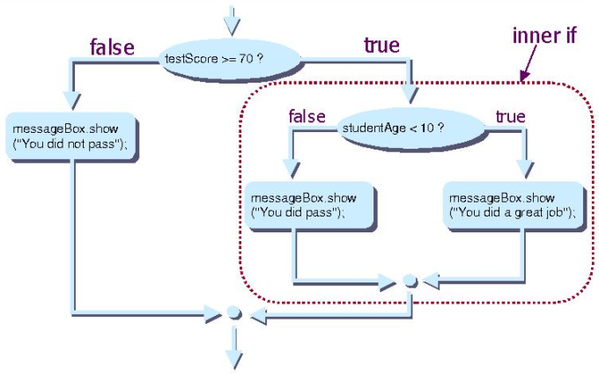
Nested if Statements
Creating More Complex Logic

Slide 17
Nested if Statements
if and if-else statements can be nested
Used inside one inside another
Each else corresponds to its closest preceding if
if (expression)
{
if (expression)
some_statement;
else
another_statement;
}
else
third_statement;

Slide 18
Nested if – Good Practices
Always use { … } blocks to avoid ambiguity
Even when a single statement follows
Avoid using more than three levels of nested if statements
Put the case you normally expect to process first
Then write the unusual cases
Arrange the code to make it more readable

Slide 19
Nested if Statements – Example
if (first == second)
{
printf("These two numbers are equal.");
}
else
{
if (first > second)
{
printf("These first number is bigger.");
}
else
{
printf("These second number is bigger.");
}
}

Slide 20
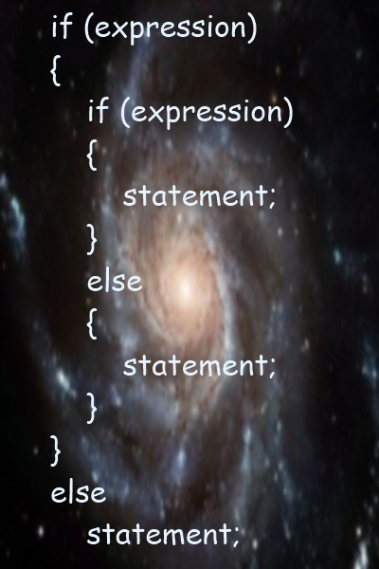
Nested if Statements
Live Demo

Slide 21
Multiple if-else-if-else-…
We may need to use another if-construction in the else block
Thus else if can be used:
int ch = 'X';
if (ch == 'A' || ch == 'a')
{
printf("Vowel [ei]");
}
else if (ch == 'E' || ch == 'e')
{
printf("Vowel [i:]");
}
else if …
else …

Slide 22
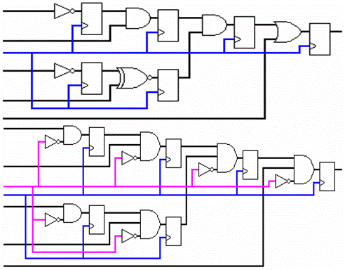
Multiple if-else Statements
Live Demo

Slide 23

switch-case
Performing Several Comparisons at Once

Slide 24
The switch-case Statement
Selects for execution a statement from a list depending on the value of the switch expression
switch (day)
{
case 1: printf("Monday"); break;
case 2: printf("Tuesday"); break;
case 3: printf("Wednesday"); break;
case 4: printf("Thursday"); break;
case 5: printf("Friday"); break;
case 6: printf("Saturday"); break;
case 7: printf("Sunday"); break;
default: printf("Error!"); break;
}

Slide 25
How switch-case Works?
The expression is evaluated
When one of the constants specified in a case label is equal to the expression
The statement that corresponds to that case is executed
If no case is equal to the expression
If there is default case, it is executed
Otherwise the control is transferred to the end point of the switch statement

Slide 26

The switch-case Statement
Live Demo

Slide 27
Using switch: Rules
Variable types like integral types and enums can be used for switch expression
The keyword break exits the switch statement
Be careful with "falling-through" multiple cases!
Use break after each case
Multiple labels that correspond to the same statement are permitted

Slide 28

Multiple Labels in a switch-case
Live Demo

Slide 29
Using switch – Good Practices
There must be a separate case for every normal situation
Put the normal case first
Put the most frequently executed cases first and the least frequently executed last
Order cases alphabetically or numerically
In default use case that cannot be reached under normal circumstances

Slide 30
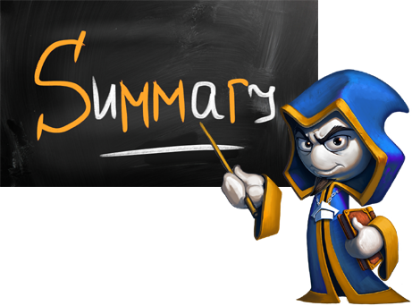
Summary
Comparison and logical operators are used to compose logical conditions
The conditional statements if and if-else conditionally execution of blocks of code
Constantly used in computer programming
Conditional statements can be nested
The switch statement easily and elegantly checks an expression for a sequence of values

Slide 31








C Programming – Conditional Statements
https://softuni.bg/trainings/1212/C-Programming-October-2015

Slide 32
License
This course (slides, examples, demos, videos, homework, etc.) is licensed under the "Creative Commons Attribution-NonCommercial-ShareAlike 4.0 International" license
Attribution: this work may contain portions from
"Programming Basics" course by Software University under CC-BY-SA license

Slide 33






Free Trainings @ Software University
Software University Foundation – softuni.org
Software University – High-Quality Education, Profession and Job for Software Developers
softuni.bg
Software University @ Facebook
facebook.com/SoftwareUniversity
Software University @ YouTube
youtube.com/SoftwareUniversity
Software University Forums – forum.softuni.bg

